Slide 1
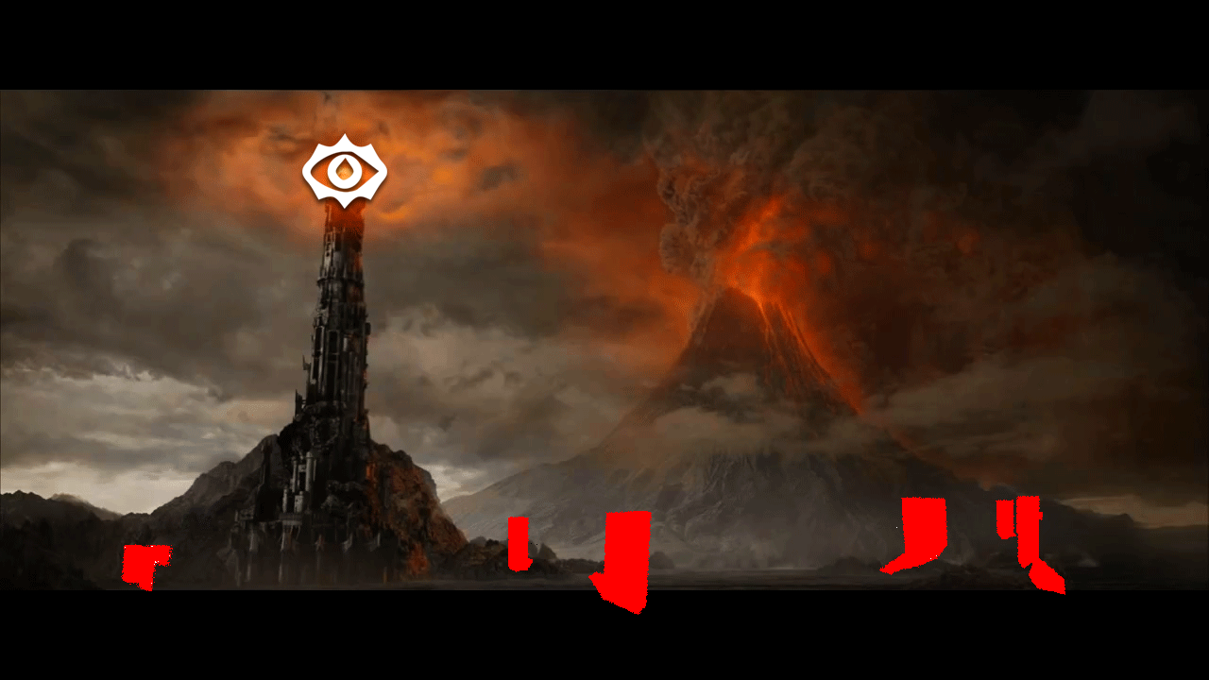
SauRayTM: A Decisive Blow to Wallhacks!

Slide 2
What is SauRayTM?
Server-side hardware-raytracing antiwallhack solution:
Middleware that runs on a game server that has a raytracing GPU
Renders a visibility focused version of each client frustum at low resolution in a smart manner:
Accounts for client-side rendering pipeline effects like shadows, global reflections or global AO.
Provides this matrix to the game server loop to filter outgoing updates!
If player A can’t see player B, player B’s updates are not transmitted to player A.
Creates a visibility matrix that outlines who can see who.
Notes:
So, what is SauRay? It is a server-side hardware-raytracing anti-wallhack solution.
What does that mean? It means that it is a middleware that runs on a game server that has a raytracing GPU.
What does it do? It renders a visibility focused version of each client’s frustum at low resolution in a smart manner.
Visibility focused because: we’re not doing this for eye-candy. We’ve just determining pairwise visibility between players.
Low resolution because: the ray budget is not infinite.
Smart manner because: when the ray budget is not infinite, you have to be smart about how you spend your rays. You have to try and target them towards where they matter (i.e. where player geometry is or where it’s likely to leave an imprint … especially when resolution is low)
It can account for all client-side rendering effects. Whatever is renderer on client-side, we can replicate server-side. Do you have shadow maps? That is raytraced shadows for us. Voxel-based AO? That is RTAO for us. Cone-traced indirect diffuse? Lambertian BSDF sampling for us. Voxel based reflections? That is raytraced reflections for us. And the list goes on.
It creates a visibility matrix which is a square matrix of ones and zeroes. Basically says who can see who. Note that this matrix is not symmetric (player A not seeing player B doesn’t mean player B can’t see player A). Also note that we store a history of visibility so each cell is a bunch of zeroes and ones potentially.
This matrix is provided to the game server loop for filtering outgoing updates. If player A can’t see player B, player A doesn’t get player B’s updates.

Slide 3
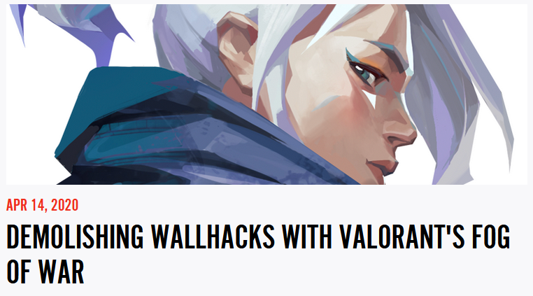
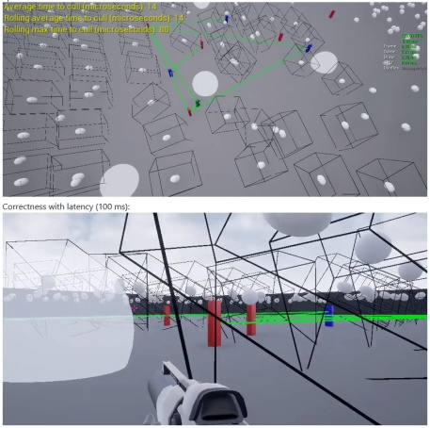
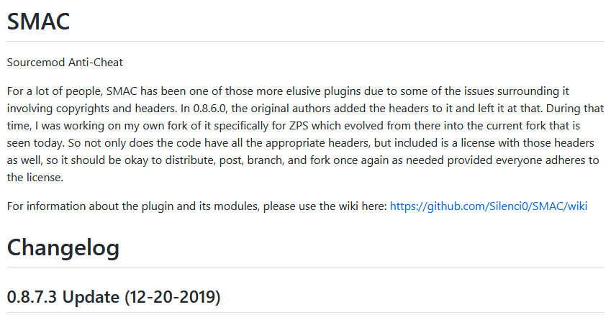
Prior work
Valorant’s Fog of War:
Too many false negatives
Abandoned in favour of floodfill PVS
CornerCulling:
Community effort by Andrew Huang + Robert @ CC:
Anticheat @ Ubi on R6:Siege
Largely unmaintained
SourceMod Anticheat (SMAC):
Source games only
Unmaintained
Same issues as above
Some paywalled stuff from Russia?
Source games only and…
…Not much better
Notes:
It’s important to note some prior work.
Valorant’s Fog of War (1st iteration) is one notable attempt. They had too many false negatives and ultimately had to switch to a floodfill PVS (Potentially Visible Set) approach. PVS approaches are traditional and not very effective.
CornerCulling was a community effort developed by Andrew Luo-Huang and Robert at Classic Community which was inspired by Fog of War’s 1st iteration. Andrew is now developing Anticheat solutions for Rainbow Six: Siege at Ubisoft. It is currently largely unmaintained and suffered from largely the same issues as Valorant’s Fog of War.
An attempt largely predating both is SourceMod Anticheat (SMAC). It is for Source games only and used ray-tracing utilities provided by the Source engine. Largely suffered from the same issues as the previously mentioned and is unmaintained.
There are same paywalled stuff from Russia and the only folks aware of them are those who have purchased them. Can’t possibly be much better that the above.

Slide 4
Issues with prior art
Extremely tight ray budget
All CPU-side
In some cases crude/conservative representation of scenery
Tons of false negatives/popping
At most checked only 8 corners on any given player
Nowhere near enough
Could not account for shadows, reflections, global AO in case they’re there
Also could not account for further complicated scenarios like a shadow in a mirror through a tiny hole in the wall
Verdict?
Not enough horsepower to solve the problem
Notes:
So what are the issues precisely?
They are all tracing CPU-side and ray budgets are extremely tight.
In some cases – such as CornerCulling – scene representation is done using large conservative cuboids that can cause false negatives and popping.
They all at most checked for 8 corners on any given player. Even in SMAC’s case where there is some semblance of ‘projecting’ the corners forward with velocity, this is still too low to account for many visibility scenarios. A player’s thigh or torso might be visible. The visibility of a tiniest part of a body through the narrowest slits in geometry can modify an enemy’s behaviour (and cues like this are of utmost importance in competitive play).
They also have no chance of accounting for complex visibility scenarios like someone’s shadow appearing in a mirror through a hole in the wall. A scenario like that is possible in something like Fortnite RTX.
What is our final verdict? Not enough horsepower to properly solve the problem.

Slide 5
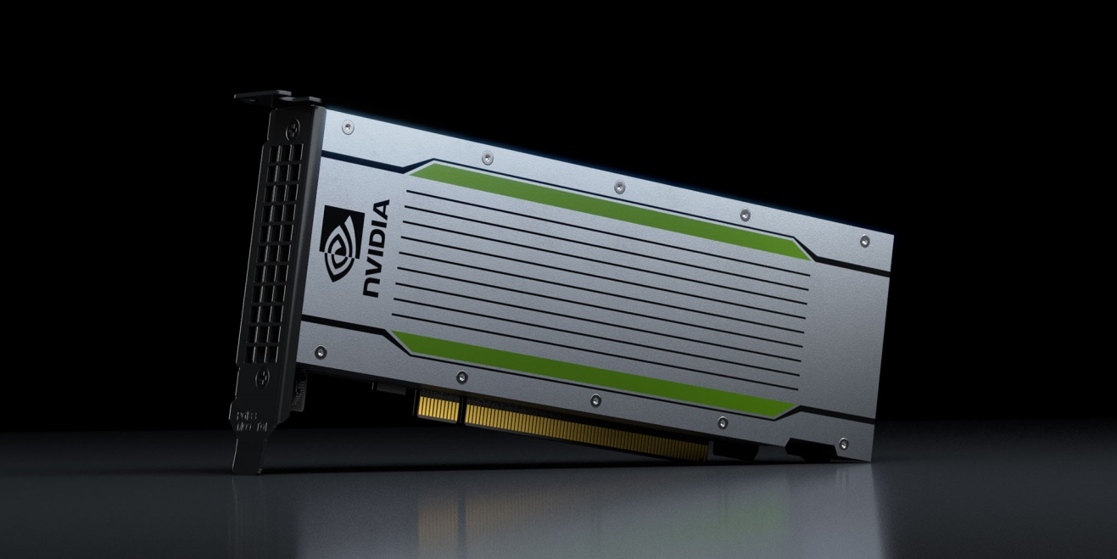
Our solution
Just give the server what it needs!
Problem solved right?
Notes:
So what is our solution?
Just throw a T4 Turing small form factor card at the blade and problem solved… right?

Slide 6
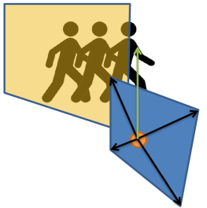
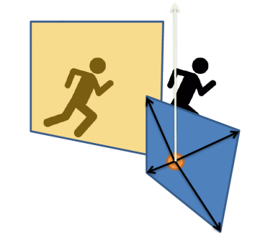
Not quite...
Ray budgets while higher, still not infinite
Need to use graphics techniques like:
Selective super-sampling
Forward projection of player geometry:
People might be running fast
and/or low tickerate!!
SauRayTM may be behind!
Parallel execution to game loop for performance
Low tickrate further necessitates!!
Notes:
Well not quite…
Having a T4 Turing means ray budgets are higher. But not infinite. You still need to be smart about how you spend your rays. You need to be informed by graphics techniques such as:
Selective super sampling: imagine a game where you have 150 players and player resolution can’t exceed 80x80. If players are going beyond a certain distance, you need to redirect more rays towards where they are or where they might be leaving imprints (i.e. shadows).
You also need forward projection of player geometry. What do we mean by that? Clip the player’s velocity against the environment and take replicas of their geometry and concatenate them along that clipped velocity vector.
Why do we need this?
Players may be running too fast across a narrow slit in the wall and may be missed. This gets exacerbated by lower tick rates relative to that velocity.
SauRay itself may be behind. What do we mean by this? In all of our integrations so far, we’ve had SauRay run parallel to the server in order to avoid adding its cost to the server game loop. This causes SauRay to be one frame behind the server at all times. As a result in needs to peek into the future in order to see what is going to be immediately visible and transmit that ahead of time. Again, with lower tickrate this becomes an even bigger necessity.
Quake II which has a standard tickrate of 10 really necessitates this.

Slide 7
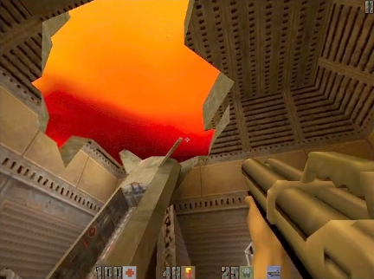
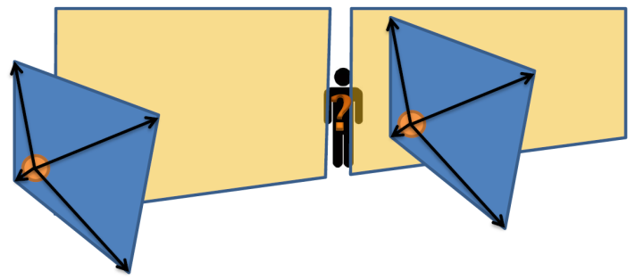
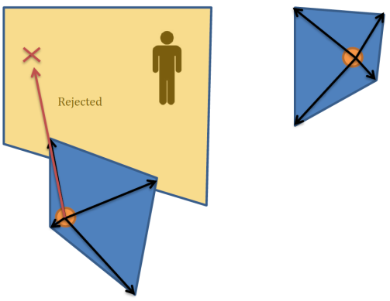
(Projection) doubles for viewers too!
Viewers also need to peek into the future for all the same reasons
Fast movement and/or low tickrate
SauRayTM may be behind
Low tickrate further necessitates!
Notes:
Everything we’ve said so far about player geometry applies to viewers as well.
Viewers need to peek into the future for pretty much the same reasons.
A viewer may be dashing across a narrow slit in the wall – in which someone may be hiding – and miss them.
Yet again, SauRay may be behind as it is running parallel to the game loop. Therefore it needs to peek into the future and transmit ahead of time.
Lower tickrate – relative to velocity – further necessitates all of this.

Slide 8
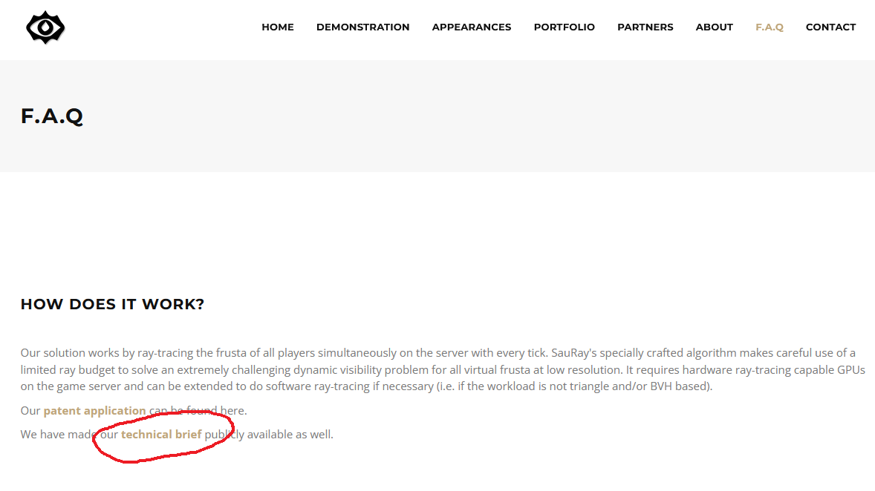
Full details are in our tech brief!
Visit http://sauray.tech
Read our F.A.Q
And our technical brief! Only 35 pages ;)
We mainly target low-latency/competitive scenarios
Though our brief also discusses our strategies for very high latencies as well (+100ms RTT)
Notes:
Full details are in our tech brief online. Read our F.A.Q first.
We mainly target low latency/competitive scenarios. We do have code paths for handling high latency scenarios but that is not where the algorithm shines best. It has to leak some more information to suppress popping as we cannot otherwise fight off delayed reception of client intent. Even then, it maintains and edge over traditional PVS methods. But again, not our main focus.

Slide 9
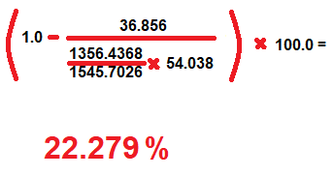
Fun fact #1: traffic goes down!
So we did some traffic analysis:
Client traffic on competitive-style matches: 2 runs, 2 sessions per run (T&CT)
CS:GO, de_nuke, 5v5
Adjusting for total session length differences (~3 minutes), we save bandwidth in absolute terms!
This is while having to add (randomized) origins for transmitted gun/walk sounds as player entity locations maybe withheld
Turns out player updates are chunky:
Contain animation data
Quake/Euler angles – legacy of idTech2
Player loadout etc.
Notes:
So we have a couple of fun facts for you:
Fun fact #1: we did some traffic analysis on a typical client’s chatter in competitive-style matches. We did 2 runs and 2 sessions per run: 1 session per each team. The game was CS:GO, the map was de_nuke and player set-up was 5v5.
Adjusting for total session length differences (23 vs. 25 minutes), we realized that we saved almost 22.3% on incoming traffic.
Why? Turns out player updates are fairly chunky. They contain:
Animation data
Quake/Euler angles for viewing directions (legacy of idTech2)
Player loadouts
And much more…
This is while we had to additionally add (randomized) origin information for transmitted gunshot and walk sounds as players may be audible while not visible.

Slide 10
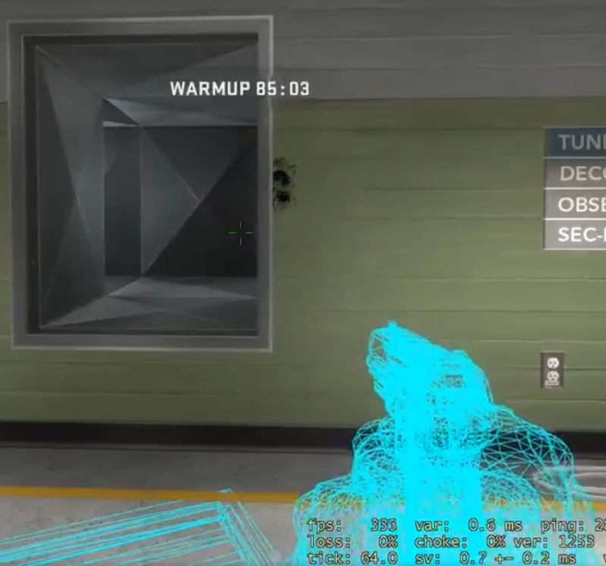
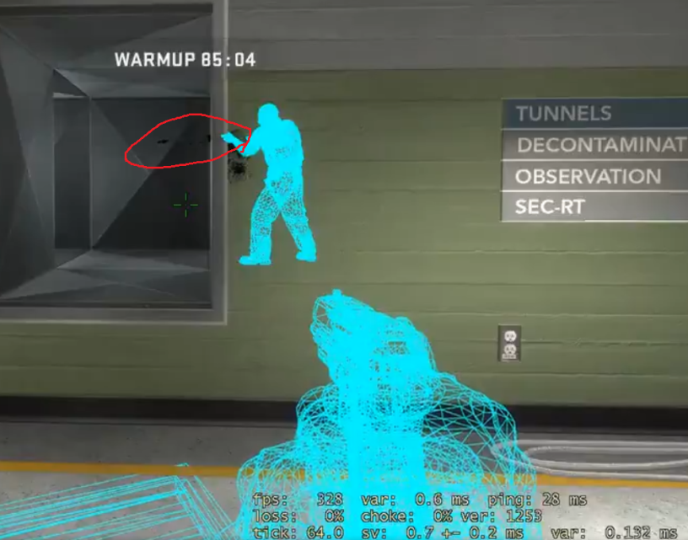
Fun fact #2: we found a bug in CS:GO!
Turns out CS:GO re-uses visibility leaf filtering for client-side occlusion culling too!
It only accounts for the player AABB and not the gun
In rare configurations the gun can go missing
Just relying on SauRayTM serverside filtering would prevent this! ;)
?
Notes:
Fun fact #2: we found a bug in CS:GO.
CS:GO re-uses visibility leaf filtering on the client side for occlusion culling as well as filtering outgoing updates server-side. It only accounts for the player’s AABB and not their gun. In some rare occasions, the gun can go missing as demonstrated in this example. Walking a little bit to the right causes the player and the gun to go missing… while the gun should clearly be visible.
If they had just relied on SauRay’s server-side filtering, this would not have happened ;)

Slide 11
Cost: (perf. and $$$)
Device | CSGO Avg ms. | TF2 Avg ms. | Server Type | # of 64-tick servers | NRE (approx. CAD) | Running cost (Annual) | Running cost (Annual 1-yr ctrct.) | Running cost (Annual 3-yr ctrct.)
RTX 2080Ti | 4.95 | 6.17 | Commodity | 2 | $1,000 | 471.08 | N/A | N/A
T4 Turing (Close to RTX 2070 Super) | 6.17 | 7.39 | Cloud - AWS G4dn.xlarge | 2 | N/A | 6,306.87 | 3,788.92 | 2,517.95
RTX 2060 OC | 7.96 | 9.65 | Commodity | 1 | $500 | 308.62 | N/A | N/A
RTX 3070Ti (Laptop!) | 7.94 | 7.94 | Commodity (Laptop!) | 1 | $1,500 | 376.22 | N/A | N/A
Notes:
Let’s look at some performance and monetary costs. (Note the perf numbers are after some quick bugfixes and there’s a lot of room for speed-ups).
We observed that an RTX 2080Ti and a T4 Turing (which is close to a 2070 Super) can both host 2 64-tick servers simultaneously (e.g. a CS:GO and a TF2 server). Obviously the long term cost of owning a RTX 2080Ti on a commodity server is far lower than hosting in the cloud. However, if your CloudOps team is not allowing you to host yourself, you do have (expensive) options in the cloud. Longer term contracts do make this cheaper.
An RTX 2060 or a 3070Ti (laptop!) can also host a single 64-tick server. Now obviously we did the laptop benchmarks for fun as you probably won’t be using those for hosting a server long term. But it was good to get the numbers.

Slide 12
Netcode architecture: do’s and don’ts!
Do:
Implement thin-client/server-authoritative architecture
We can deal with its absence… kinda. Better to have.
Scrutinize user-supplied data (y-FOV, aspect ratio etc.)
Use non-conservative geometry simplification
Get rid of small occluders…
Be mindful of side-channels:
Obfuscate/randomize origins, stream audio etc.
Trace projectiles, gunshot point light spheres etc.
Don’t:
Assume player data to be always available
Pack origin when necessary
Send more data than necessary
Radar pins don’t need 3D locations
Notes:
Here are some Do’s and Don’ts for your netcode architects:
Do’s:
Implement thin-client/server-authoritative architecture. We can deal with its absence somewhat. For instance, we can implement measures server-side to prevent clients from spamming the server with random frusta trying to break the algorithm. Or detect unfeasible player movement. However, generally speaking this is better to have.
Scrutinize user-supplied data like frustum specifications. If folks under-report their frustum dimensions it places them at a disadvantage (causes popping in the periphery of their fields of view). If they try to over-report those dimensions, they can be checked against reasonable maximums server-side and rejected. In all our integrations – Q2, TF2, CS:GO – we did not have access to such information server-side. We simply assumed a 16:9 aspect ratio maximum (width-height-ratio of 1.77778) and a y-FOV of 106 degrees Celsius for CS:GO and 90 degrees Celsius for Quake2.
You can use non-conservative geometry simplification. Generally speaking, lower triangle counts usually mean faster ray-tracing (not always as bad BVHs can be created via decimation and slow things down but that is rare). Use this to your advantage. You can also get rid of small occluders. If it’s too small for them to hide behind, chances are you don’t need them.
Be mindful of side channels:
Obfuscate and randomize sound origins as they go out. As the recipient gets further and further away, the randomization can increase without impacting sound spatialization. Better yet, stream audio. They cannot defeat that.
Trace projectiles (or even vehicles) related to players. If they can’t see them, don’t transmit them. You can also create spheres that can be associated with gunshot point lights. If the sphere is not visible, don’t send out the gun shot point light.
Don’t:
Always assume player data to be always available. Pack additional origin information when necessary (i.e sound positions).
Don’t send more data than necessary. If you’re sending a pin that is going to be displayed on a 2D radar, don’t send the full 3D position. Limit yourself to 2D information. This was a particular issue with our CS:GO integration as radar pins were sent out in 3D. We could only laterally randomize those locations as the elevation mattered: it showed whether a player was above, below or at your elevation. We also could not randomize more or less based on distance to recipient as these pins were broadcasted out to everyone. Sigh.

Slide 13
We have stuff to show!
We have Paris servers running until Monday! (AWS eu-west-3)
(Afterwards) you can visit our US West Coast servers! (AWS us-west-2)
Running until further notice…
Details are on Twitter: @antiwallhack and our website.
NOTE: We don’t advocate breaking T.O.S
However, if you know what you’re doing, come and test our schtuff! ;)

Slide 14
Thank you!
Time for
demo and Q&A!

